Slide 1
IMPROVE QUERY PERFORMANCE WITH AGGREGATIONS
BY NITIN

Slide 2
OBJECTIVE
I understood the working of how to use the performance analyzer
I learned about how to set model properties for data model

Slide 3
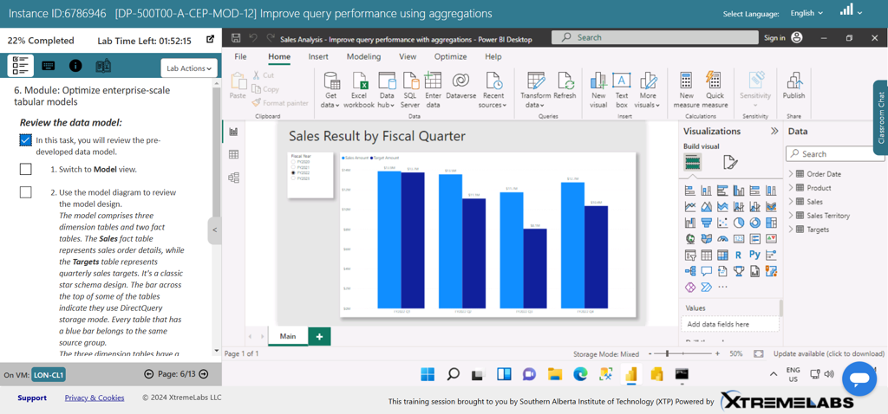

Slide 4
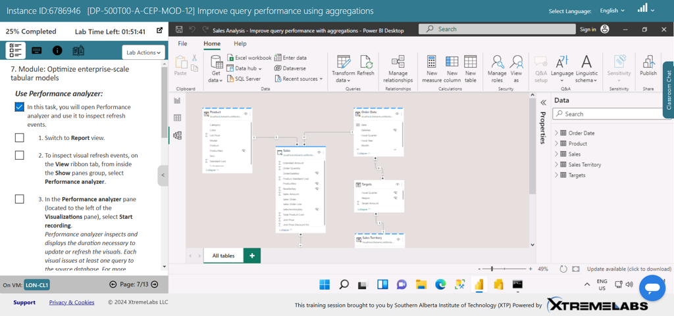

Slide 5
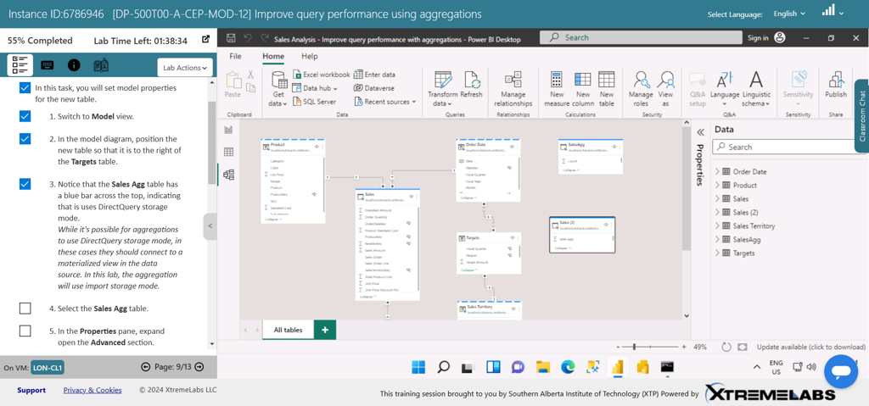

Slide 6
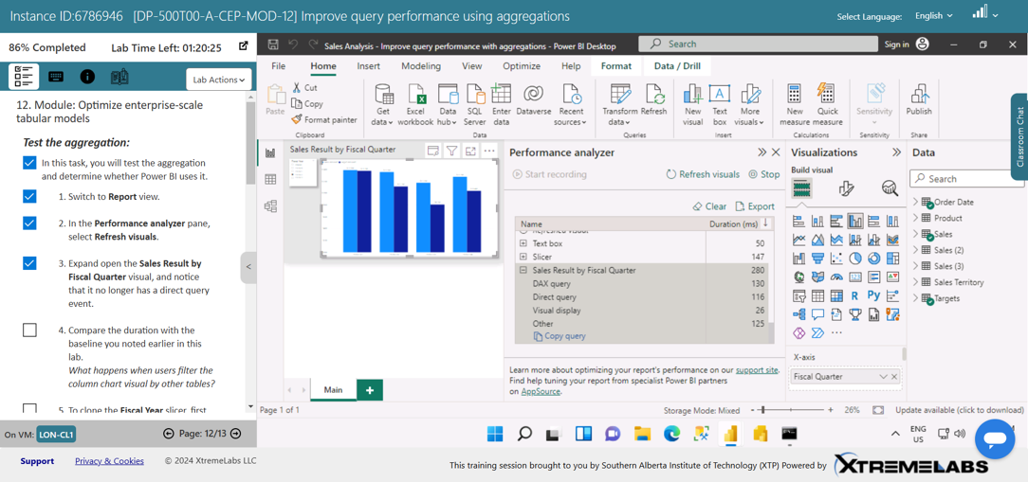

Slide 7
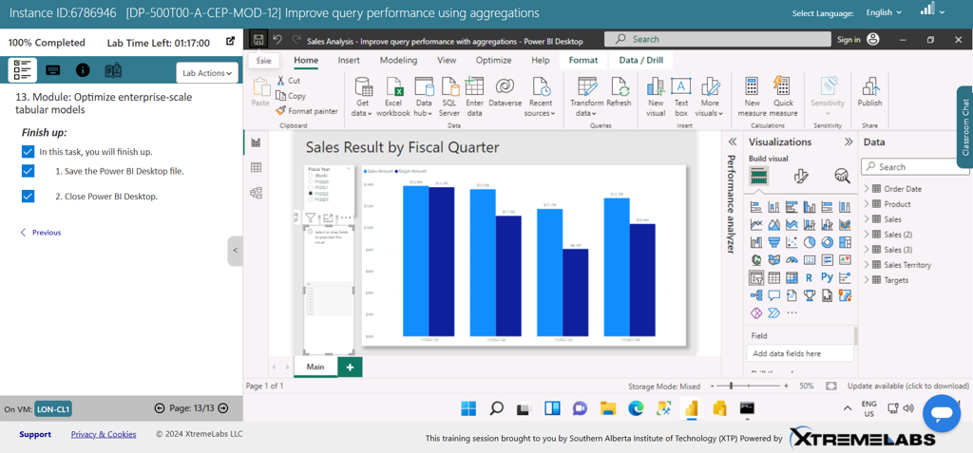

Slide 8
